Slide 1
Team: XIV
Challenge Theme
Agri Marketing

Slide 2
E-KRISHI HUB
Be a smart Farmer…….
Team Member
Ravi Shankar Verma
Pooja
Neha Sharma
Vipin Arya
Pragyan Paramita

Slide 3
Common Problems in Agri Marketing…
High Input Cost
Involvement of too many Intermediates
Defective Weights and Scales
Illiteracy and Lack of Unity among Farmers
Lack of Financial Resources and Govt. policies
Lack of Organized Marketing System
Lack of Transport Facilities and Store Houses
Lack of Standardization

Slide 4
Business Model
Links
Services
KISSAN SMART CARD
AGRI INPUTS
AGRO INDUSTRIES
FARMERS
BANK
E KRISHI HUB
APP
LOCAL AND OTHER MANDI
AGRO PROCESSING INDUSTRIES
CONSULTANCY

Slide 5

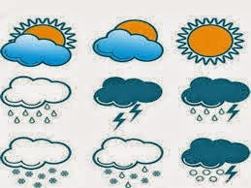
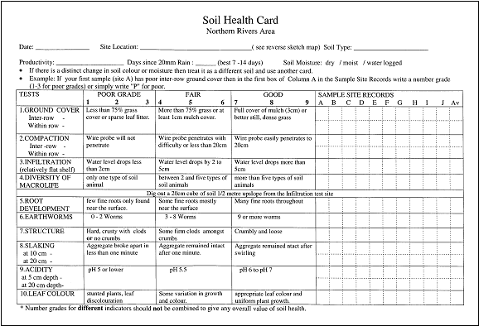


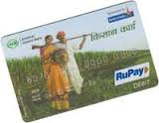





Experts Involved
e -Agro advisory services
WORKING PRINCIPLE
WEATHER FORECAST
SOIL HEALTH
(Soil Health Card and Fertility Map)
Kissan Smart Card
CROP HEALTH
Visual Diagnostic Kit (VDK)
Information
Feed back and queries
e KRISHI hub
e agri input service provider
e Agri marketing

Slide 6

Linkage with banks
Buying of Agri inputs
Be a Smart Farmer…
Marketing of agro produces
Transaction of money
Feature of Kisan Smart Card
Easy Accountability

Slide 7
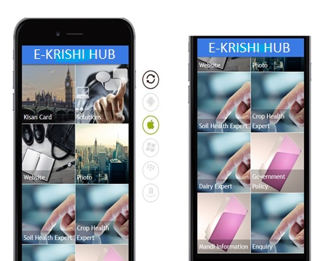

E-KRISHI HUB APP
Online Agri input and Output Market
One touch solution by agri experts
Updates and Alerts of govt policies
Updates of weather data
Updates of modern agro technologies

Slide 8

Revenue Strategy
E buying of agri inputs
Agro Based Input Company
Margin
Kissan Smart Card
Customer
Agro Produce
E-Krishi Hub
Banks
Agro Based Output Industry,
MANDI
Commission
Agri Commodities
Margin

Slide 9

What E KRISHI HUB does???
Better organization of farmer’s business system
Reduction in middle man and minimal exploitation of farmers
Brings all farmers on a single platform
Better awareness regarding govt policies and schemes
Provides better marketing facilities at profitable prices

Slide 10
Thank You…

